Slide 1
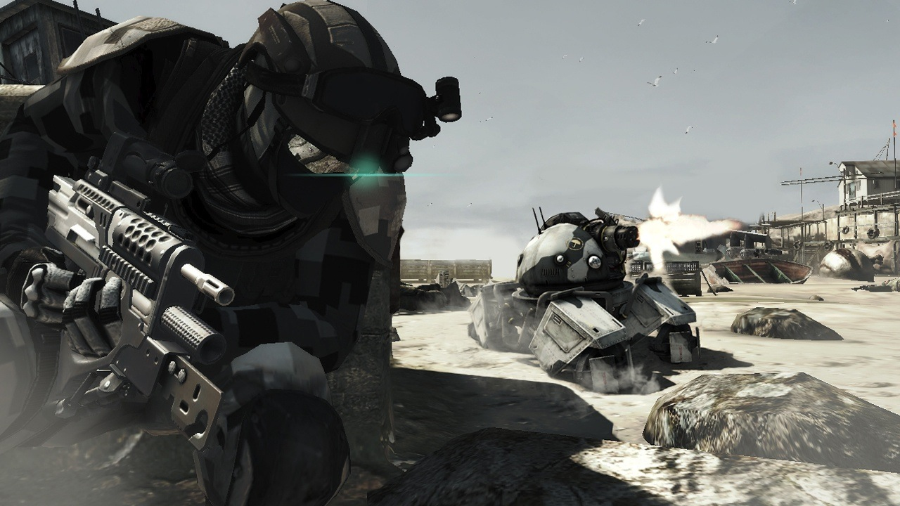
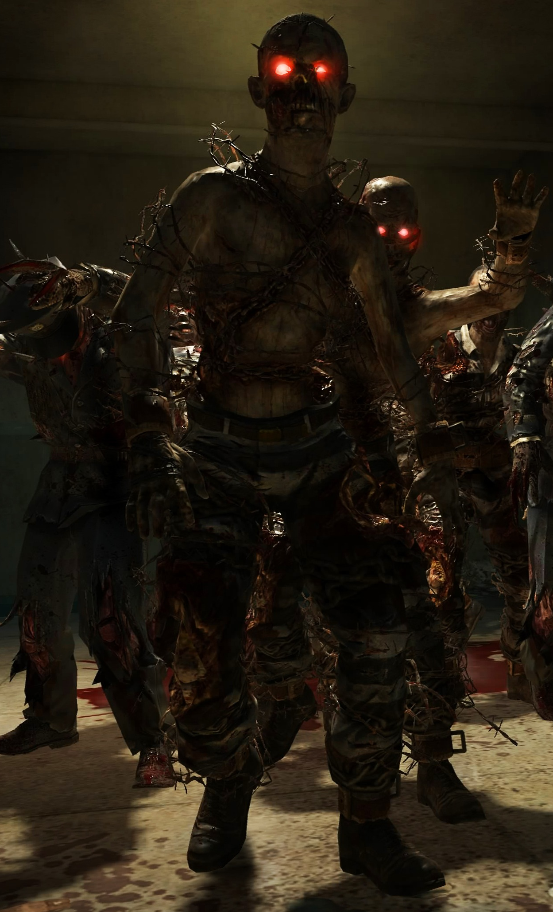
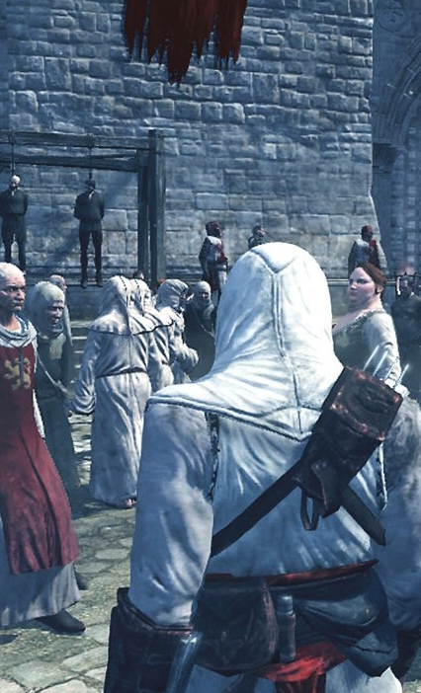
AI for Games
ICP2025 | ICP3025 | ICE4732
Lecture 1 : Introduction

Slide 2
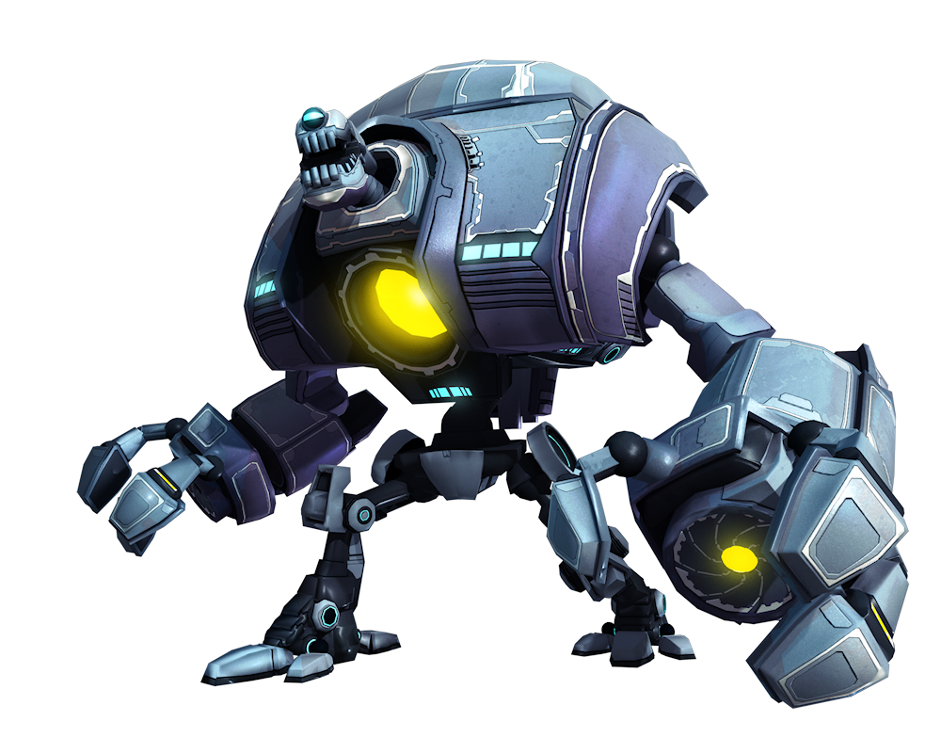
Today’s Lecture
Module Introduction
Lectures and Labs
Assignment
Report
Exam
Recommended Reading

Slide 3
Introduction

Slide 4
What is AI for Games?
Module taken by 2nd Year Computer Science + Creative Tech
Module taken by 3rd Year Computer Information Systems
Module taken by Masters in Computer Science
Module also known as
“Applications of AI”
“Applied AI”
“AI & Games Design”
Aim is to teach various AI techniques applicable in video games, simulations and intelligent systems

Slide 5
What is AI?

Slide 6
What is Game AI?

Slide 7
What does AI stand for?
AI stands for Artificial Intelligence
AI is a very broad term…
There is an argument that the “AI” in the term “Game AI” overstates its worth, as game AI is not about intelligence, and shares few of the objectives of the academic field of AI
“Real” AI addresses fields such as machine learning, decision making based on arbitrary data and even the ultimate goal of a strong AI that can reason.
“Game AI” often consists of a few rules of thumb or heuristics that are designed to facilitate a good gameplay experience.

Slide 8
AI in Games
Game AI has many different functions in games
Opponents, team mates, NPCs, directors, creators etc.
We will look at these in detail next week
Bad AI can negatively affect the believability of characters, break immersion and ruin gameplay through bugs
YouTube “AI game bug” for many great examples

Slide 9
Why study Game AI?
The games industry is worth over $100 billion, meaning it is one of the most profitable applications of AI
The games industry has promoted rapid growth in several computing sectors, most notably graphics cards which can increasingly render scenes that are photo-real
But in many cases AI is still unable to solve relatively simple tasks…

Slide 10
Beyond Games
Most of this module will look at AI through the lens of Video Games
Games are essentially real-time simulation, and AI technology and techniques used in games can also be applied in other areas
Agents
Crowd Simulation
Serious Games + Education
Virtual + Augmented Reality
Intelligent Systems
Robotic Simulation

Slide 11
Lecturer’s Background

Slide 12


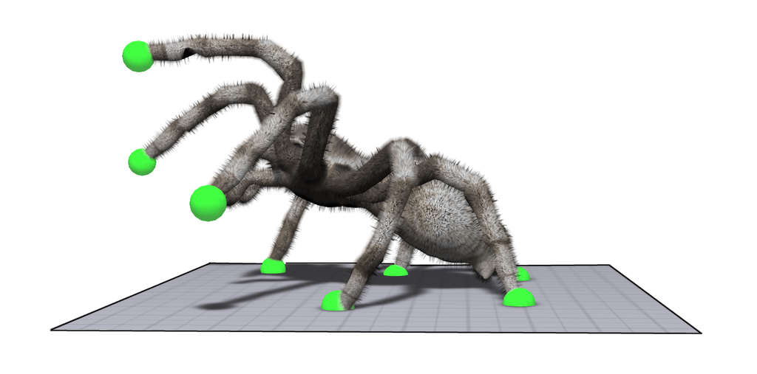
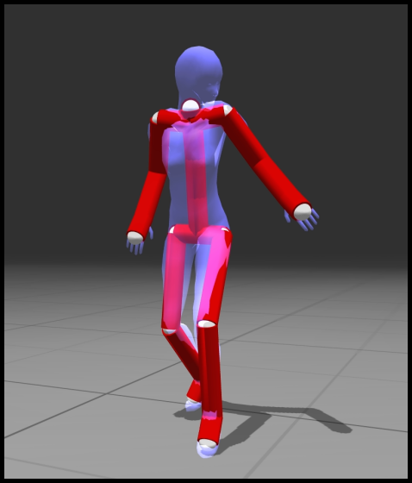

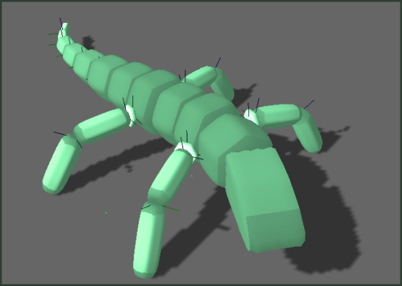
Procedural Animation (C/C++)

Slide 13
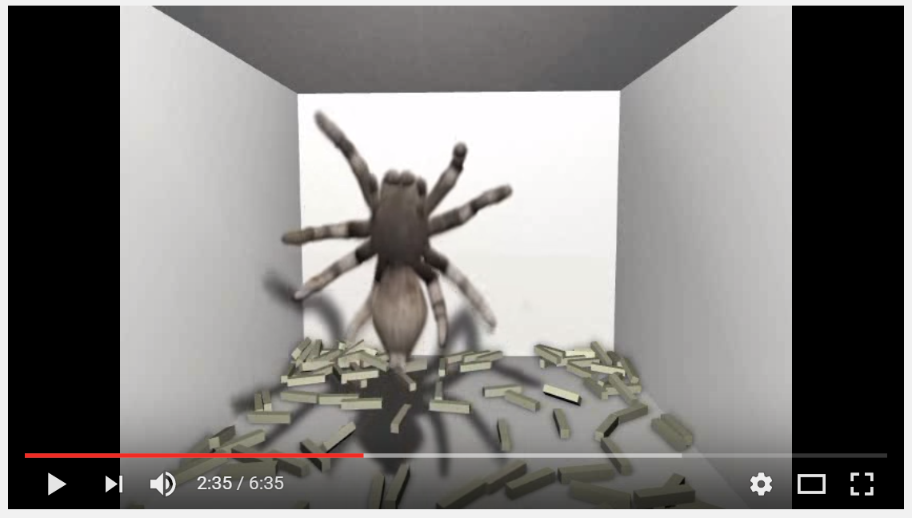
Procedural Animation
https://www.youtube.com/watch?v=I1P_B65XW4I

Slide 14



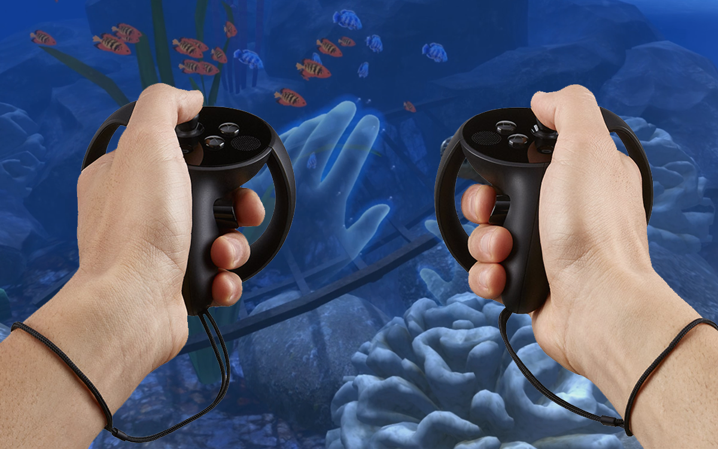
Ocean Rift (VR Safari Park)

Slide 15


Ocean Rift (VR Safari Park)

Slide 16

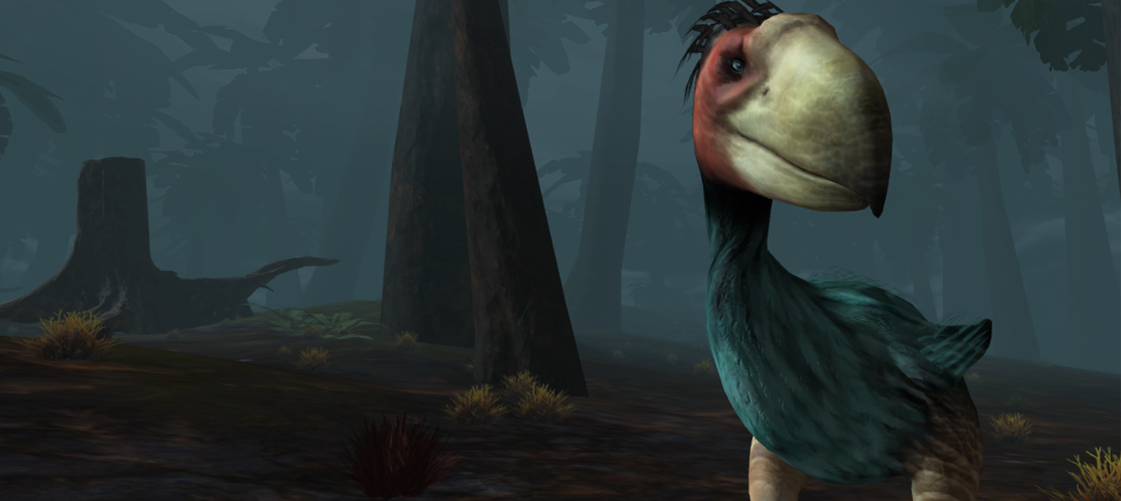
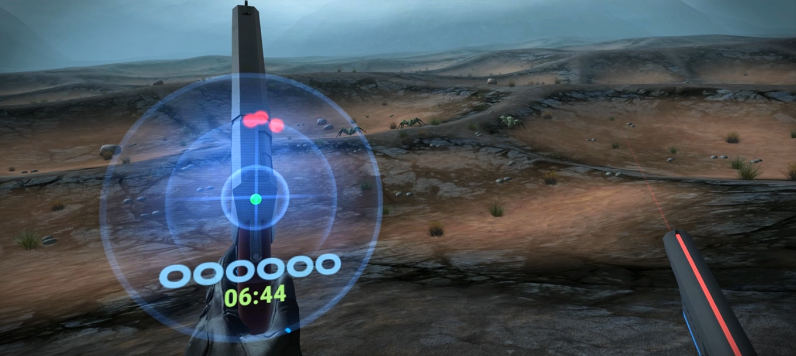
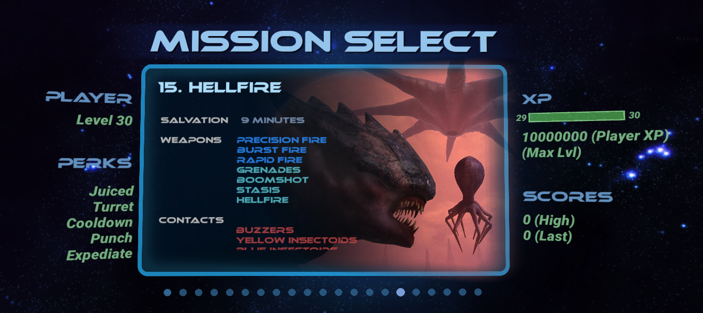
Crashland (VR Shooter)
https://www.youtube.com/watch?v=DCvnd55koIc

Slide 17
Lectures and Labs

Slide 18
Lectures
Lectures are on Monday at 11am in SLT (Small Lecture Theatre)
We have a two hour slot booked every week (11-1pm)
We will occasionally make use of the second hour*
*Mostly used for miscellaneous contact time, backup lecture slot

Slide 19
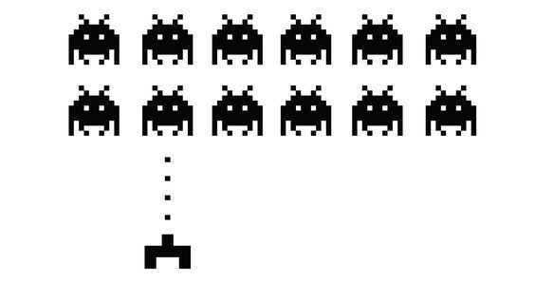
Lectures
Week 1 : Introduction (we are here)
Week 2 : Role of the AI
Week 3 : Reactive Agents Part I
Week 4 : Reactive Agents Part II
Week 5 : Navigation and Search
Week 6 : Artificial Stupidity
Week 7 : Learning and Evolution
Week 8 : Procedural Animation
Week 9 : New Technologies
Week 10 : Assignment / Exam Revision
Week 11 : Assignment Marking / Exam Revision
Week 12 : Assignment Marking / Exam Revision

Slide 20
Labs
The labs for this module run on Monday + Wednesday + Friday…
Your timetable should tell you which lab you are in
Monday Lab : 2pm-4pm (ICP2025, DS207)
Wednesday Lab: 9am-11am (ICP3025 + ICE4732, DS319)
Friday Lab: 2pm-4pm (ICP2025, DS319)
Lab attendance will be monitored

Slide 21
Contacts
I am usually found in my office (DS-329).
If you need help the best thing to do is email me at llyr.ap.cenydd@bangor.ac.uk
Alternatively after the lecture or in the labs

Slide 22
Assignment

Slide 23
Assignment
This module contains a single assignment
Spans weeks 1-10
This is all you will be doing in the labs
You are also expected to work extensively outside labs
Assignment has two parts
Creating a prototype game (AI programming)
Writing a blog (report)
The assignment document is available on blackboard
Lets have a look…

Slide 24
ICP2025 Assignment
Your assignment contributes to 70% of the overall module mark based on the following split:
Final Game: 45%
Blog: 25%
We highly recommend you read and return to the assignment document regularly over the course of the semester

Slide 25
ICP3025 Assignment
Your assignment contributes to 50% of the overall module mark based on the following split:
Final Game: 25%
Blog: 25%
We highly recommend you read and return to the assignment document regularly over the course of the semester

Slide 26
ICE4732 Assignment
Your assignment contributes to 70% of the overall module mark based on the following split:
Final Game: 35%
Blog: 35%
We highly recommend you read and return to the assignment document regularly over the course of the semester

Slide 27
Mark Breakdown
Y2: Computer Science
Creative Tech
Y3: Computer Information Systems
Y4: Masters
Assignment: 70%
Game Implementation: 45%
Blog / Writeup: 25%
Exam: 30%
Assignment: 50%
Game Implementation: 25%
Blog / Writeup: 25%
Exam: 50%
Assignment: 70%
Game Implementation: 35%
Blog / Writeup: 35%
Exam: 30%
There are three distinctly different modules which will be taught within this course of study. Although the assignments will be similar they will be assessing different things. For more details look at your module descriptor and assignment sheet (available on Blackboard).

Slide 28
Game Engines

Slide 29
Game Engines
This module is platform agnostic – we are not here to teach you a specific programming language or engine
The aim is to teach you how to implement various Game AI algorithms
You are free to use any programming language or game engine for your project

Slide 30
Game Engines
There are many programming languages and game engines available
We recommend you work from your own desktop / laptop
If you have a desktop / laptop
Unity (recommended)
Netlogo (recommended)
Gamemaker
Unreal Engine
If you want to use University lab machines only
Netlogo (recommended)
Java

Slide 31
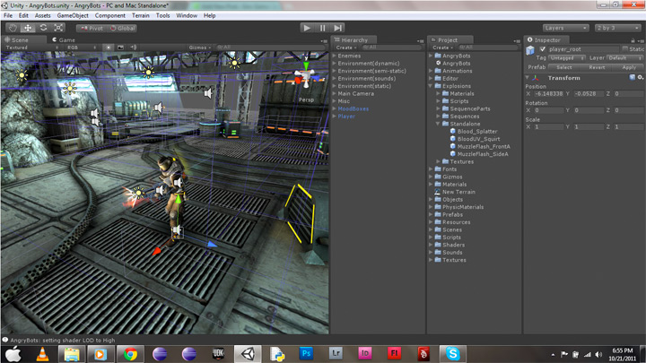

Unity
On Lab machines (new for 2019)
Recommended if you have a decent desktop or laptop
Unity Engine is the most popular game engine on the planet. Can be program in C#, Javascript or Boo (Python based)
We can offer technical support and expertise in Unity
Free to install and use on personal machines
https://www.unity3d.com

Slide 32
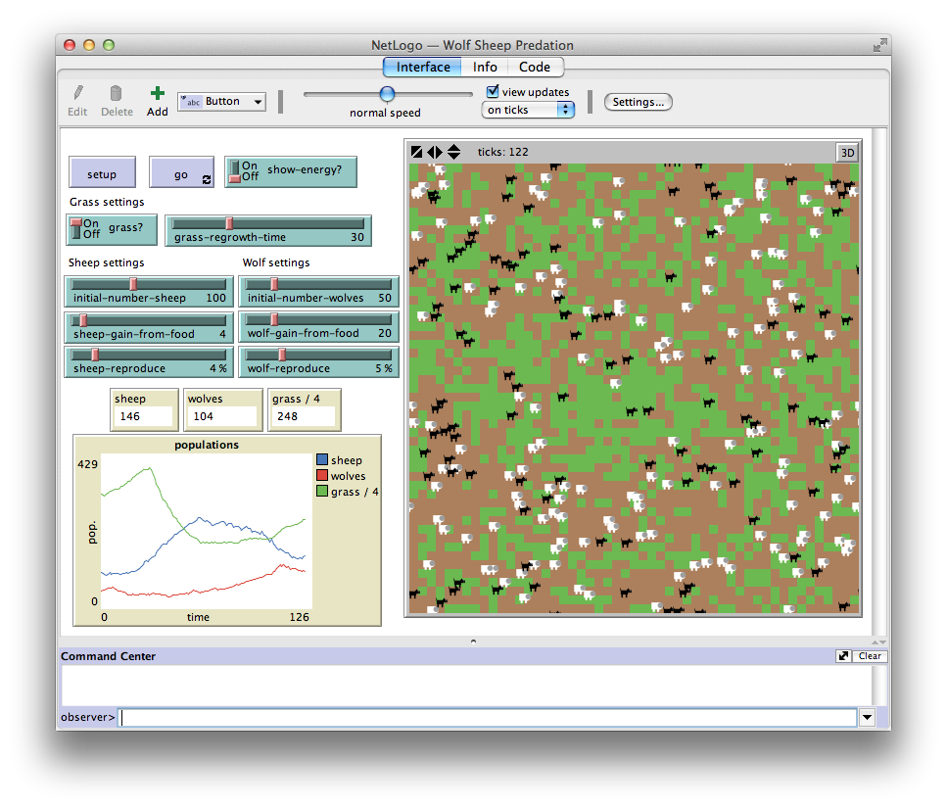
NetLogo
Recommended if you have a basic laptop or want to work primarily on University machines
Free, Agent orientated language
Allows for quick implementation of agent-based algorithms
Some limitations will make achieving a very high mark more difficult
https://ccl.northwestern.edu/netlogo/

Slide 33
Other (Unsupported) Options
You can use alternative platforms if you wish
However we will not be able to provide you with the same level of support
While we will try to help you where possible we cannot guarantee that we will be able to solve platform or language specific issues.
You may already have experience in one of these engines, or you may want to experiment with them to create a specific type of game. If so then feel free to use whichever options suits you best.

Slide 34

Java
Java has a built in 2D Graphics library (Swing)
Can be imported in Netbeans, Eclipse etc.
Many tutorials available online
This is the expert option!

Slide 35
Javascript + HTML5
Requires nothing specific to be installed as it can be programmed in notepad
Can be run in the browser, many of which have powerful debugging tools
Canvas and WebGL can be combined to create interactive 3D games
Many successful HTML5 games are online through protals such as MiniClip

Slide 36


Other Engines
Java
HTML 5
Unreal Engine (C++)
GameMaker
PyGame (Python)
Many others…

Slide 37
Your Game

Slide 38
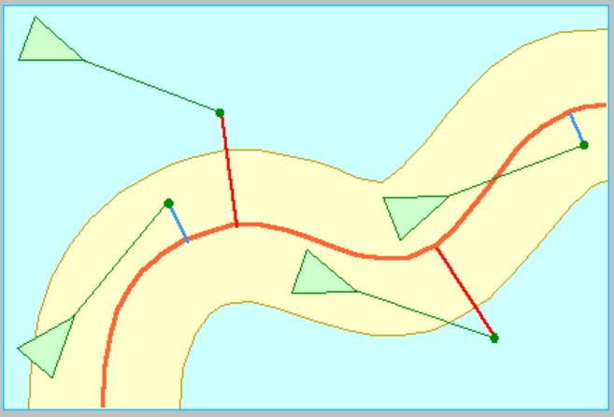
Your Game
You can make any game you like
Read assignment sheet carefully
Your game has to be continuous
AI should move around smoothly
No board games or turn based games
Marking scheme will guide you
Please ask if you are unsure

Slide 39
A look at the marking scheme…

Slide 40
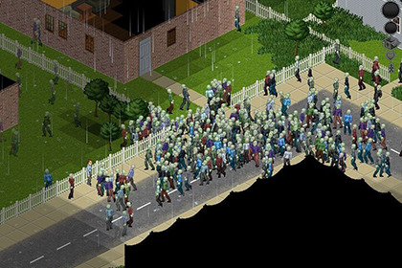

Example Game Ideas
Zombie game
AI Zombies can chase player, navigate around objects, group together etc.
Very compatible with marking scheme
Racing game
AI cars drive around track, overtake other cars, different personalities etc.
Robot vacuum cleaner
Navigate rooms, doors, objects
Learn room layout, improve with time
Procedurally generate rooms
Underwater Game
Simulate school of fish, predators, 3d movement

Slide 41
Labs
You are free to come to the lab to work on your project, write your blog, do research, request technical help
It’s not for socialising, playing video games is not “research” ;)
There will be a set of three labs available on blackboard for you to work through (no submission)
Use them as a springboard for your project

Slide 42
Mid-semester marking
In the middle of the semester you will have the opportunity to be mock-marked
“If you handed this assignment in today,
this is the mark you would get”
Acts like a “sanity check” and lets you figure out what to concentrate on in the final month of development and report writing

Slide 43
Your Report

Slide 44
Your Report
Alongside your program, you also need to be writing a report in the form of a blog
There is a guide on Blackboard on how to setup a Wordpress blog
There is no strict requirement for you to put your report in a blog format (it can be a word document), but it is highly recommended you do so

Slide 45
Your Report
You should aim to write at least one blog post a week
These will be more diary-like at the start
“This week I looked at all the various game engines available…”
“This week I’ve been sketching out various types of AI behaviour that could be implemented in my game…”
Later on they will become more technical
Images
Algorithms
Code snippets
Videos

Slide 46
Assignment Tips

Slide 47
Assignment Tips
You must design and implement a computer game which has AI
You will only be marked on the AI – We will not mark you on the graphics or any other game components
You may implement any kind of game you wish as long as you complete the objectives in the assignment sheet

Slide 48
Assignment Tips
Remember that the aim of your assignment is to program different types of AI. There are no explicit marks for graphics, sound, physics, gameplay etc.
Always refer to the marking scheme, it basically tells you how to get a good mark in this module
Don’t neglect the blog - write a blog post a week minimum. A few paragraphs won’t take long and it will add up over the weeks

Slide 49
Recommended Reading
Game AI Pro
Some editions available online for free: http://www.gameaipro.com/
Available from £41 on Amazon (new and used)
Covers much more than we will discuss in this module alone
A great reference book for anyone doing the module and superb guide for anyone who is considering game development as a possible career path

Slide 50

Background Reading
Artificial Intelligence: A Modern Approach
Available from £30 on Amazon (new and used)
Written by Stuart Russel and Peter Norvig
Again, covers much more than we will discuss in this module alone
Not strictly AI for Games, but provides a vast overview of AI approaches

Slide 51
Web Content
Throughout the course of this module, we will provide links to certain content available online
There is a certain amount of self study you should be undertaking in this module. Some of this is from the web content.
Choosing to read that content or not is your decision, however it may be assessed in exams so it is advised that you do…

Slide 52
Conclusion

Slide 53
Assignment + Report
Have fun making your game
Remember it’s all about the AI!
You have the marking scheme from day 1, very easy to pass this module if you put effort in every week
When you have an idea, feel free to run it past us so we can make sure you’re on the right track

Slide 54
Lab Week 1
You must submit a link to your blog on Blackboard by the end of this week
The lab this week will give you the opportunity to experiment with your game development environment of choice
Next week you will begin working on your first AI algorithms. If you want to read ahead the labs are available on Blackboard

Slide 55

Lab Week 1
Your goals for this week:
Research and test different game engines / languages
Start thinking about game ideas
Start creating an environment for your game
Create and write your first blog post
Post a link to your blog on Blackboard

